Slide 1
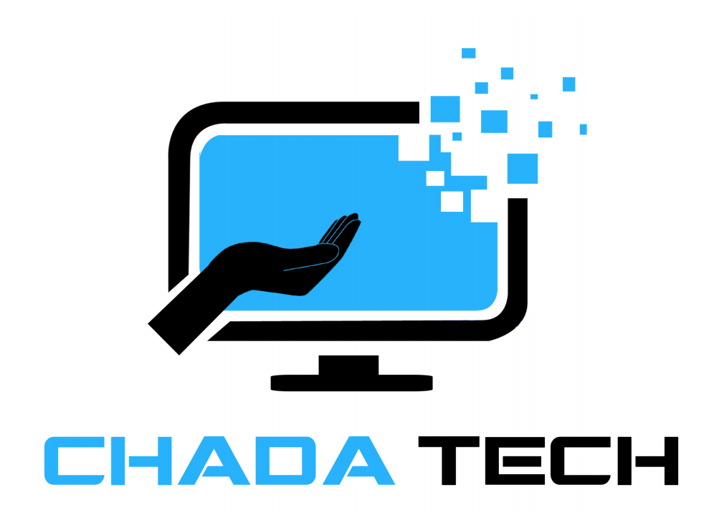
Agile vs. Waterfall: A Comparative Analysis for ChadaTech
Scrum-Agile Implementation for SNHU Travel Project
Prepared By: Sharif Ayesh
12/05/2024

Slide 2

Explaining Agile Roles Product Owner: Manages the product backlog and prioritizes features. Importance: Aligns development with business goals and customer needs. Scrum Master: Facilitates team collaboration and removes blockers. Importance: Ensures the team adheres to Scrum principles and stays productive. Development Team: Builds the product increment. Importance: Delivers working software in each sprint.

Slide 3
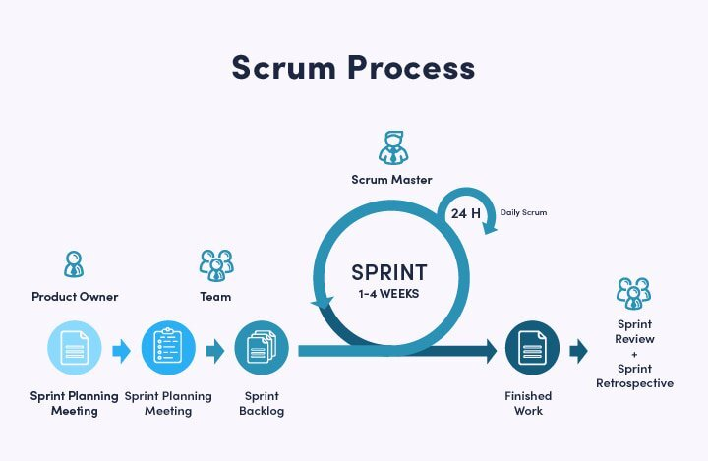
Agile Phases Importance
Planning: Collaborate with team members. Gather Requirements.
Sprint Planning: Provides precise, actionable tasks for the development team to execute within a sprint.
Development: Delivers working software frequently, enabling quicker feedback from stakeholders.
Review: Encourages iterative improvements and ensures the product meets user needs.
Retrospective: Promotes continuous improvement in team processes and performance.

Slide 4
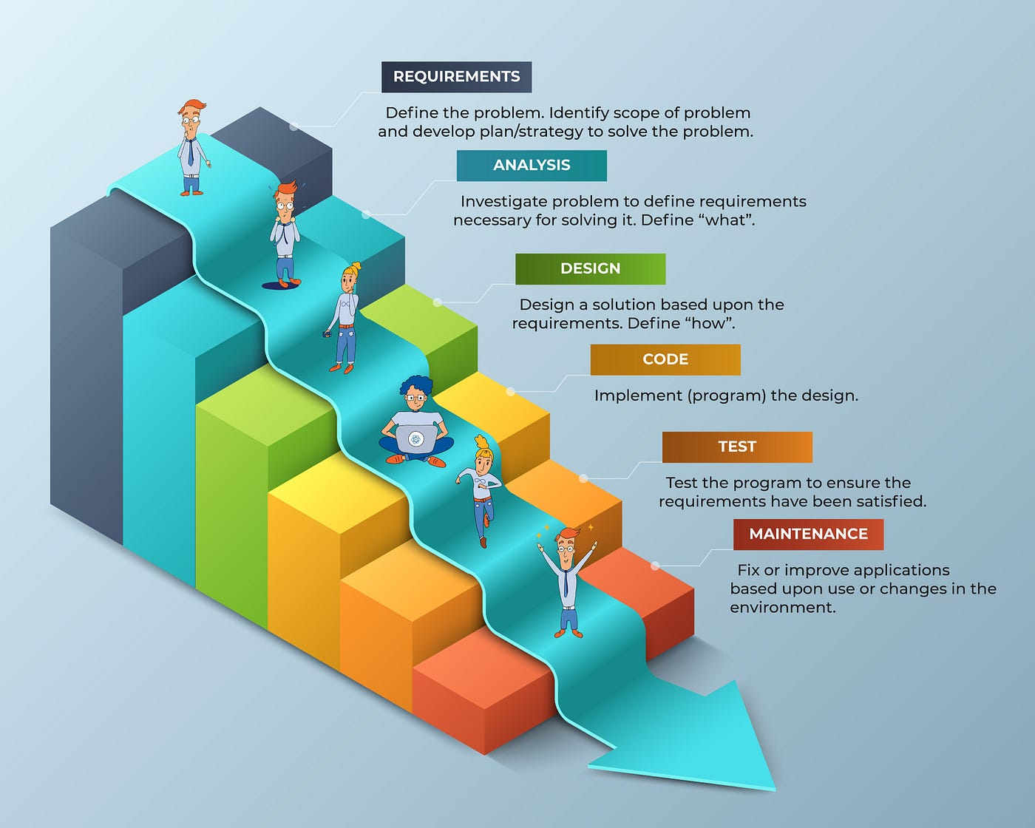
Water Fall Model 1. Requirements 2. Analysis 3. Design 4. Code 5. Test 6. Maintenance

Slide 5
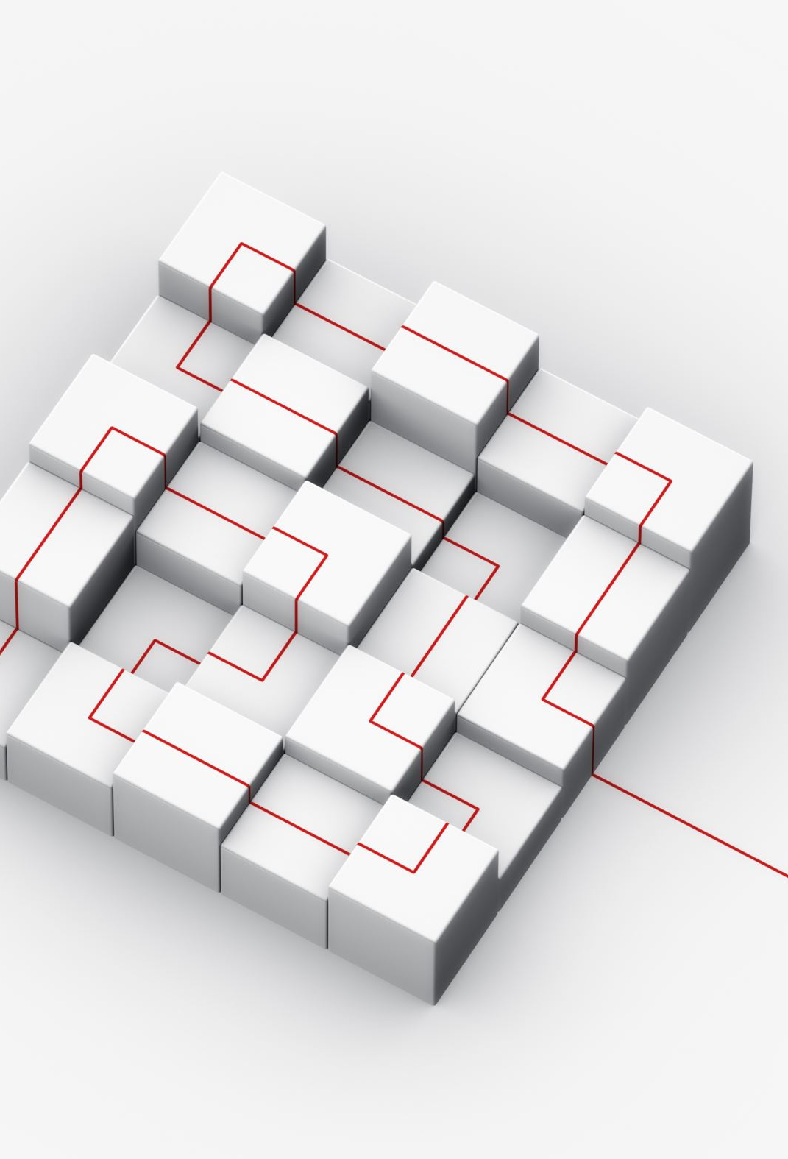
Overview of the Waterfall Model Definition: A traditional, linear approach to software development where each phase must be completed before moving to the next. Phases: Requirements Gathering Design Development Testing Deployment Maintenance Key Characteristics: Sequential and rigid. Minimal room for flexibility. Changes are costly and difficult to implement once a phase is completed.

Slide 6
Waterfall vs. Agile Approach
Waterfall
Agile
Rigid, follows a fixed sequence.
Final product delivered at the end of the project
Feedback is collected late, usually after testing.
High risk due to limited room for corrections.
Sequential handoffs between isolated teams or departments.
Process-driven, focused on completing each phase in order.
Changes are expensive and difficult to implement.
Ideal for projects with clear, unchanging requirements
Highly adaptable to changing requirements.
Incremental deliverables provided after each sprint.
Continuous feedback after each iteration.
Low risk, issues are identified and resolved early.
Cross-functional teams working collaboratively.
Customer-driven, focused on delivering value early.
Changes are integrated seamlessly during iterations.
Ideal for projects with dynamic or evolving requirements.

Slide 7
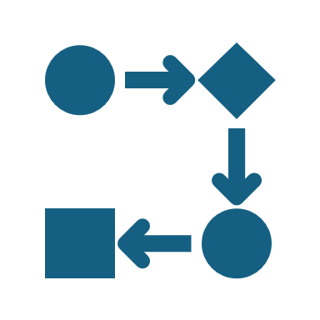
Conclusion: Agile for the Future of ChadaTech Waterfall is structured and sequential but lacks flexibility. Agile is iterative, collaborative, and adaptable to changing requirements. Agile fosters faster delivery of working software and continuous feedback. Recommendation: Agile is ideal for projects like SNHU Travel, where requirements evolve and stakeholder feedback is critical. Agile's flexibility and iterative nature align with ChadaTech's goals of innovation and efficiency. Agile is not just a methodology; it’s a mindset. Adopting Agile will enable ChadaTech to stay competitive, deliver value faster, and better meet client needs.

Slide 8
References: Schwaber, K., & Sutherland, J. (2020). The Scrum Guide: The Definitive Guide to Scrum: The Rules of the Game. Scrum.org. Retrieved from https://scrumguides.org. Royce, W. W. (1970). Managing the Development of Large Software Systems. Proceedings of IEEE WESCON. Retrieved from https://www.cs.umd.edu/class/spring2003/cmsc838p/Process/waterfall.pdf

